Slide 1
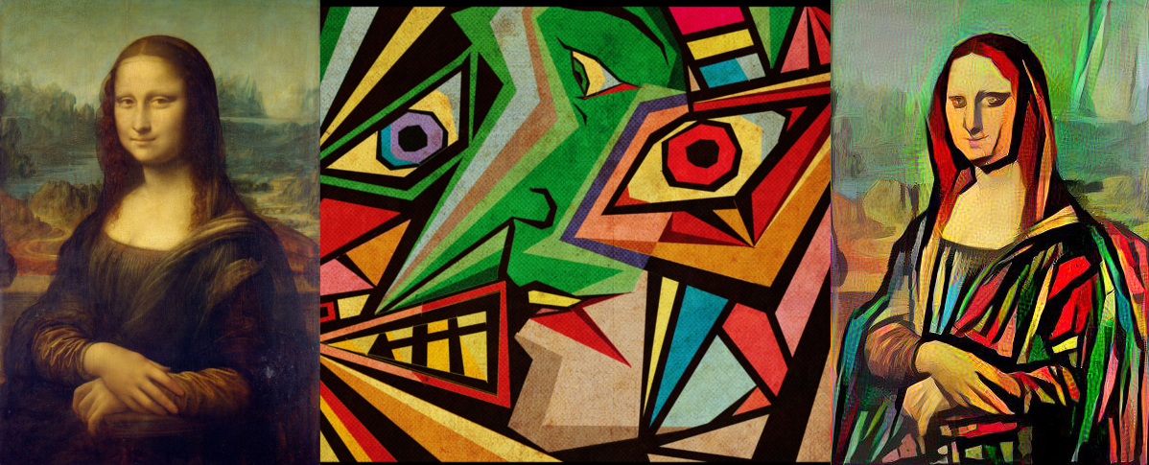
Extensions to
Neural Style Transfer
CSCI 566
Deep Learning and its Applications
Team : 4D Tensor
Praveen Iyer, Swarnita Venkatraman, Sneha Bandi, Neha Chawla

Slide 2
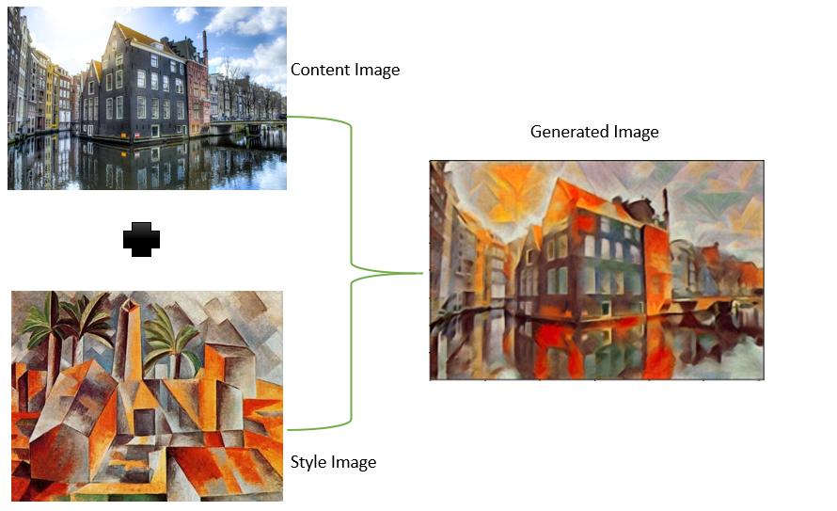
Introduction
There have been many successful implementations of NST in recent years for specific domains, e.g., artistic, semantic and photo-realistic; however, existing approaches have limited flexibility in extending to other domains as different style representations are often specific to particular domains.
In most works, the stylization process is confined to the pixel domain and there could still be distortions in the style patterns of the transferred results.
Besides, in practical situations, users may not have exact image enhancements or corrections in mind but may still be interested in enhancing their images.
+
Given a content and a style reference image, the process of applying styles to generate output image that retains the core elements of the content image but appears to be in the style of the reference image is known as Neural Style Transfer (NST). [5]

Slide 3
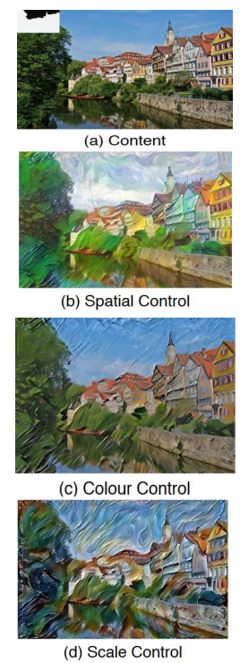
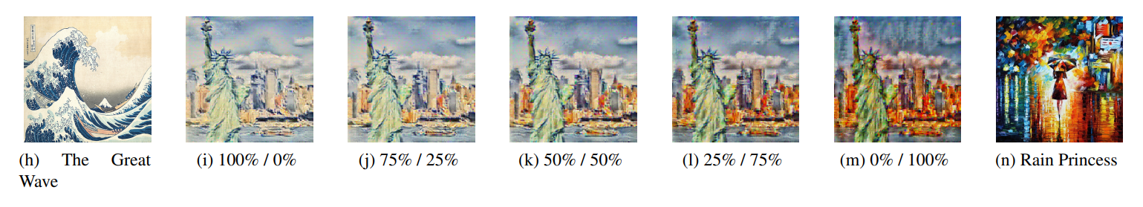
Objective
In order to deal with such applications and challenges, we propose explorations of several extensions and improvements to the original neural style transfer technique. These will primarily center on the concept of Cascade Style Transfer.
We aim to create a novel pipeline incorporating user feedback based on different neural style models and investigate the original loss functions to enhance the styled image based on user preferences.
Exploring Multiple style transfer, we aim to apply the styles of multiple images to one content image by using cascading style transfer and improve the quality of the images by weighing given styles.

Slide 4
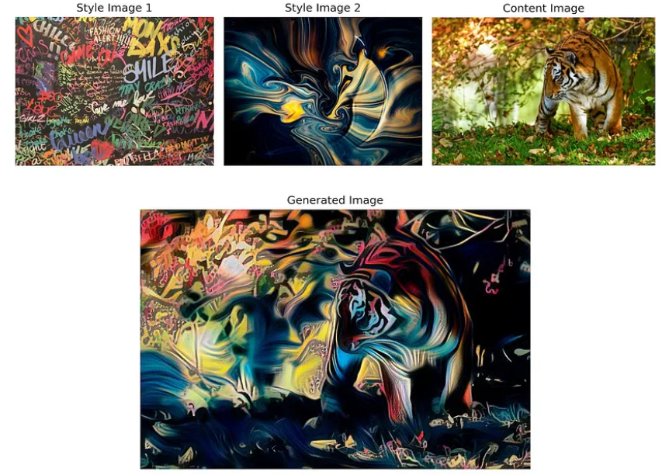
2.a Existing Work
In recent times, NST has achieved good performance, but studies highlighting improving its stability, quality, flexibility and evaluation are still in its early stages, specifically using user feedback.
Multiple style transfer in NST enables styles of multiple images to be transferred to a single content image by a simple modification to the style image loss. However, existing challenges with multiple style transfer include:
Increased training time if separate networks are tied to each style
Adding multiple styles lessens the impact of each individual style especially when the styles are somewhat different[2]
Higher style loss when blending two style images compared to having just one style image[2]
Cascade Style Transfer combines multiple existing NST approaches in serial and parallel, evaluated against quantifiable quality factors and human observed heuristic knowledge to determine the reasonable cascade order. It is shown to improve the stylistic quality and flexibility of the generated image. [1][3]
Source:https://towardsdatascience.com/mixed-neural-style-transfer-with-two-style-images-9469b2681b54

Slide 5
2.b Key Ideas for Novelty
There is not enough literature available on work done in incorporating user feedback with NST to modify/personalize the generated image based on user’s preferences and doing multiple style transfer using Cascade Style Transfer.
Generated images from the model can be modified using image processing techniques by slightly modifying weights for style and content. Besides, the user preferences based on the feedback provided for multiple generated images can be understood and the model can be retrained to suit the user tastes by modifying dataset or the loss function. This can in turn improve the quality of the generated image based on the user's preferences through a closed feedback loop.
Style from the style image is known to be preserved more in Cascade Style Transfer while in traditional Multi Objective Networks content from content image is known to be preserved more. [1]
Additionally, we are proposing to perform multiple style transfer using cascade style transfer to exploit its benefit of preserving style more, giving us room to incorporate multiple styles. Besides, existing literature on a combined methodology has not been encountered yet. This can potentially lead to generated images with better quality and style preservation.

Slide 6
3. What difference does it make?
Our combined methodology dismisses the need for different networks for each image and therefore heavily optimizes training time
This has potential to greatly benefit future NST applications that incorporate style from multiple images while maintaining high quality
Customization based on user feedback allows for higher user satisfaction as well and can open the floor to increased customization/personalization capabilities in future applications
On the other hand, our methods as well as NST in general have the potential to phase out the need for human artists.
Once an artist has existing work, our methods could create additional art based on the same styles from that work much more efficiently compared to how long it would take the artist themself to create more.
This ties in to the negative argument that, over time, advancements in artificial intelligence are replacing the need for humans in the workforce.

Slide 7
4. Challenges and Solutions
Problem | Solution
Contradicting styles of two style images might lead to unsatisfactory output. | Break the style of the image into multiple components and then choose one for each component leading to style resolution.
Different orders in which the style images are passed in the cascade style transfer can lead to vastly different outputs. | Use an architecture where we stack both ordering in parallel leading to order invariant outputs.
No clear expected output or ground truth for Neural Style Transfer. This means that for evaluation we rely on qualitative methods which can be challenging. | Explore quantitative evaluation metrics helping us decide clearly whether our model has been an improvement or not.
Tweaking the existing 3 metrics (content fidelity, global effects and local patterns) in the loss function might be insufficient to account user feedback. This will remain an uncertainty until we complete further initial work. | Can possibly design more fine grained metrics for our use case.

Slide 8
5. Costing and Computational Time
Resource reserved for 1 minute | SUs charged
1 CPU | 1
4 GB memory | 1
1 A100 or A40 GPU | 8
1 V100 or P100 GPU | 4
1 K40 GPU | 2
=>30 minutes per experimental NST model for 1000 epochs ~ 3 experiments,
=>Total (30 min x 3) 90 minutes on GTX GPU
=> 8 SU/min making it 720 SUs.
Given the above metrics, we propose that the cost and computational time will be within the bounds of reference for the baseline algorithms used for NST techniques.
We have calculated tentative algorithmic complexity based on the referenced literature survey.
Because we are not training the model from scratch, it should be computationally low.

Slide 9

6. Division of Work
As a team we plan on dividing the tasks equally between all the team members, coherent to proposed timeline.
We would collaboratively work through designing the project pipeline and identifying evaluation metrics.
Internally the individual tasks for achieving our goals are laid such that steps like data acquisition, preprocessing, modeling, training, evaluation and testing are evenly divided between all team members, to ensure fair understanding and learning.
We also plan on reviewing each other's work and giving feedback to each other.

Slide 10
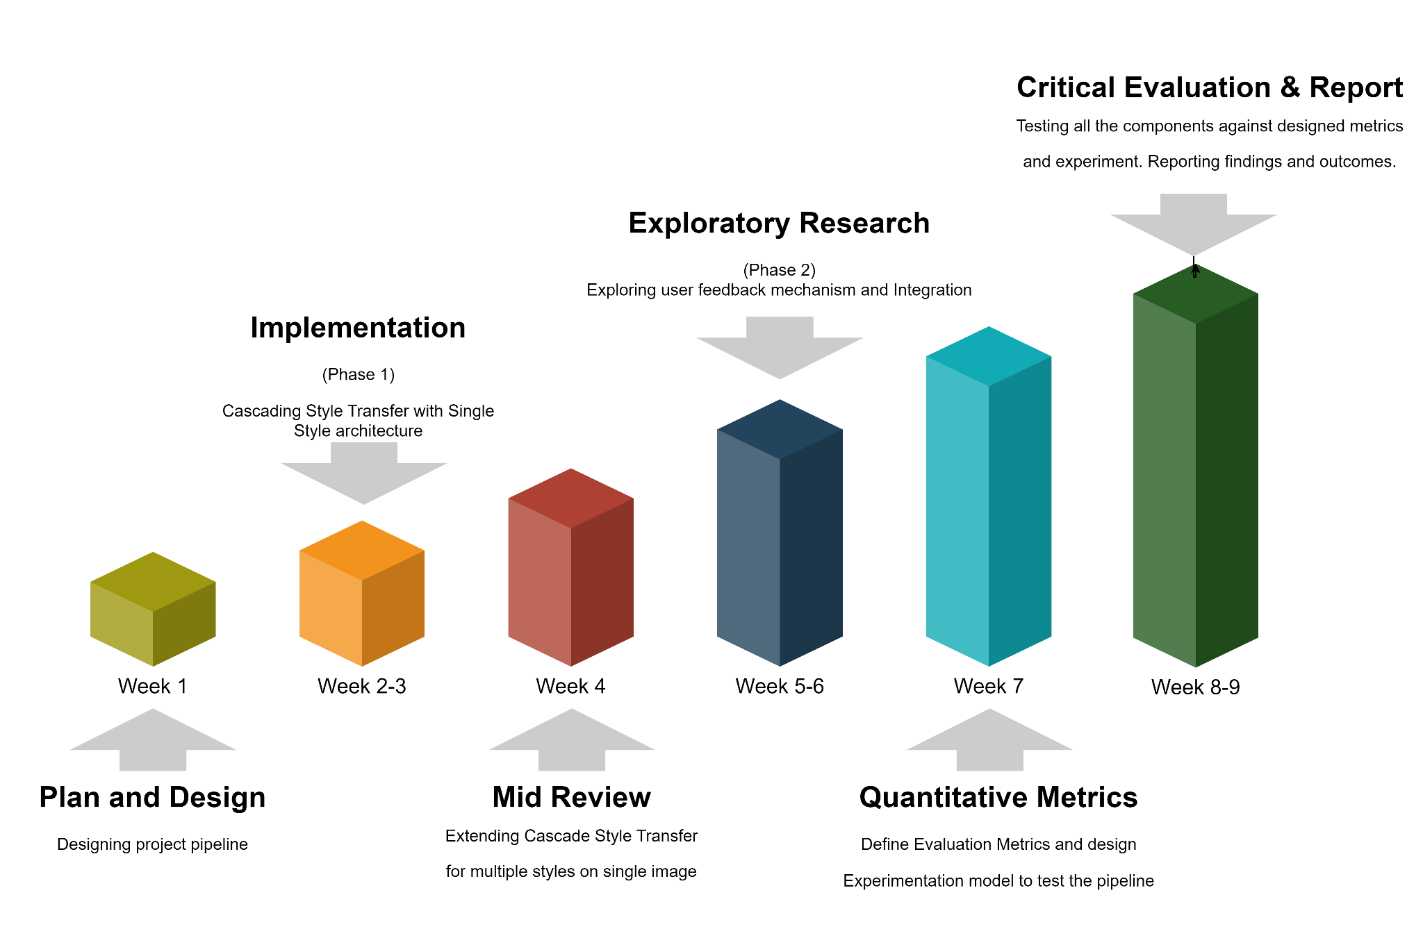
7. Expected Timeline

Slide 11
References
Wang, Z.; Zhao, L.; Chen, H.; Zuo, Z.; Li, A.; Xing, W.; and Lu, D. 2021. Evaluate and improve the quality of neural style transfer. Computer Vision and Image Understanding (CVIU), 207: 103203 [1]
Noah Makow, Pablo Hernandez, Exploring Style Transfer: Extensions to Neural Style Transfer http://cs231n.stanford.edu/reports/2017/pdfs/428.pdf [2]
Cascade Style Transfer, Under review as a conference paper at ICLR 2020, https://openreview.net/pdf?id=BJeuKnEtDH [3]
Gatys, L.A., Ecker, A.S., Bethge, M.: A neural algorithm of artistic style. arXiv preprint arXiv:1508.06576 (2015) [4]
Jianbo Wang , Huan Yang, Jianlong Fu, Toshihiko Yamasaki, and Baining Guo, Fine-Grained Image Style Transfer with Visual Transformers. arXiv:2210.05176v1 [5]
Hussein A Aly and Eric Dubois. Image up-sampling using total-variation regularization with a new observation model. IEEE Transactions on Image Processing, 14(10):1647–1659, 2005.
Alex J Champandard. Semantic style transfer and turning two-bit doodles into fine artworks. arXiv preprint arXiv:1603.01768, 2016.
Dongdong Chen, Lu Yuan, Jing Liao, Nenghai Yu, and Gang Hua. Stylebank: An explicit representation for neural image style transfer. In Proceedings of the IEEE conference on computer vision and pattern recognition, pp. 1897–1906, 2017.
Tian Qi Chen and Mark Schmidt. Fast patch-based style transfer of arbitrary style. arXiv preprint arXiv:1612.04337, 2016.

